Slide 1
Azure (2)
Let’s Grow 17-11-2021

Slide 2
Blob Storage

Slide 3


Azure Blob storage
Object storage solution in the cloud
Blob storage is designed for:
Serving images or documents directly to a browser
Storing files for distributed access
Streaming video and audio
Writing to log files
Storing data for backup and restore, disaster recovery, and archiving
Storing data for analysis by an on-premises or Azure-hosted service
Accessible via a HTTP/HTTPS API
Notes:
Microsoft Azure Blob storage is the Microsoft object storage solution for the cloud. Blob storage is optimized for storing massive amounts of unstructured data. Unstructured data is data that does not adhere to a particular data model or definition, such as text or binary data.
Users or client applications can access objects in Blob storage via HTTP/HTTPS, from anywhere in the world. Objects in Blob storage are accessible via the Azure Storage Representational State Transfer (REST) API, Azure PowerShell, Azure CLI, or an Azure Storage client library. Client libraries are available for a variety of languages, including .NET, Java, Node.js, Python, Go, PHP, and Ruby.

Slide 4
Azure Blob storage resource hierarchy
Storage account
Container
Blob
Header.jpg
Images
Media
Ad1.png
Videos
Intro.mp4
Notes:
Azure Blob storage allows access to stored data through its resources. Azure Blob storage contains the following components:
Storage account: This refers to an account that you can use to access Azure Storage. In terms of hierarchy, it’s the parent account of the container and blob resources.
Container: This refers to a collection of objects that are grouped together and accessed by using the same base Uniform Resource Identifier (URI).
Blob: This refers to an object, typically a media file or a disk, that is stored in the container.

Slide 5



Blob types
Types of blobs
in Azure Storage
Block blobs
Append blobs
Page blobs
Notes:
Azure Storage supports three types of blobs: block, append, and page. Each blob type is designed to handle specific types of objects in storage. For example, block blobs are ideal for media files, append blobs are suitable for log files, and page blobs almost directly emulate storage disks.
Let’s find out about the different blob types that are available for storage.

Slide 6
Block blobs
Comprise blocks of data
Ideal for data that is stored in blocks—up to 100-MB chunks
Simultaneous upload of large blobs with a single write operation
A single block blob can include up to 50,000 blocks
Notes:
Block blobs let you upload large blobs efficiently. Block blobs comprise blocks of data. Each block is identified by a block ID. You create or modify a block blob by writing a set of blocks and committing them by their block IDs.
A block blob can include up to 50,000 blocks. Each block can be a different size, up to a maximum of 100 megabytes (MB); 4 MB for requests using REST versions before 2016-05-31. The maximum size of a block blob is therefore slightly more than 4.75 terabytes (TB), or 100 MB × 50,000 blocks.
For REST versions before 2016-05-31, the maximum size of a block blob is a little more than 195 gigabytes (GB), or 4 MB × 50,000 blocks.
If you’re writing a block blob that is no more than 256 MB (64 MB for requests using REST versions before 2016-05-31) in size, you can upload the entire block blob with a single write operation.

Slide 7
Append blobs
Append blobs include the following characteristics:
They are composed of blocks
They are optimized for append operations
They are ideal for performant logging
Notes:
Let’s examine the characteristics of append blobs.
An append blob comprises blocks and is optimized for append operations. When you modify an append blob, blocks are added to the end of the blob only through the Append Block operation. Updating or deleting existing blocks isn’t supported. Unlike a block blob, an append blob doesn’t expose its block IDs. Each block in an append blob can be a different size, up to a maximum of 4 MB, and an append blob can include up to 50,000 blocks. The maximum size of an append blob is therefore slightly more than 195 GB, or 4 MB × 50,000 blocks.
Append blobs are optimized for scenarios where data is added to the end of the contents of an existing blob. This makes append blobs the most performant choice for many logging solutions where text is added to the end of the log.
We will learn about page blobs next.

Slide 8
Page blobs
Composed of 512-byte pages
Similar to hard disk storage
Ideal for virtual hard disks
Pages created by initializing the page blob and specifying the size
Content to be added within 512-byte page boundaries
Writes to page blobs commit immediately
Notes:
Let’s examine the characteristics of page blobs.
Page blobs are a collection of 512-byte pages that are optimized for random read and write operations. They are like hard disk storage and are ideal for virtual hard disks. To create a page blob, you initialize the page blob and specify the maximum size the page blob will grow. To add or update the contents of a page blob, you write a page or pages by specifying an offset and a range that aligns to the 512-byte page boundaries. A write to a page blob can overwrite just one page, some pages, or up to 4 MB of the page blob. Writes to page blobs happen in-place and are immediately committed to the blob. The maximum size for a page blob is 8 TB.

Slide 9
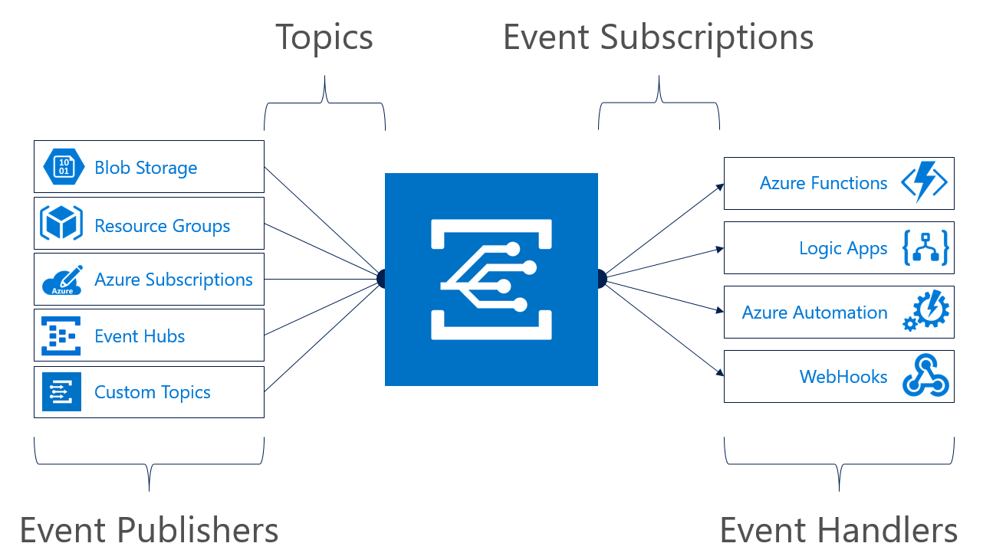
Blob events
Notes:
Azure Storage events allow applications to react to the creation and deletion of blobs using modern serverless architectures. It does so without the need for complicated code or expensive and inefficient polling services. Instead, events are pushed through Azure Event Grid to subscribers such as Azure Functions, Azure Logic Apps, or even to your own custom http listener, and you only pay for what you use.
Blob storage events are reliably sent to the Event grid service which provides reliable delivery services to your applications through rich retry policies and dead-letter delivery.
Common Blob storage event scenarios include image or video processing, search indexing, or any file-oriented workflow. Asynchronous file uploads are a good fit for events. When changes are infrequent, but your scenario requires immediate responsiveness, event-based architecture can be especially efficient.

Slide 10
Blob container properties
Property | Description
ETag | This is a standard HTTP header that gives a value that is unchanged unless a property of the container is changed. This value can be used to implement optimistic concurrency with the blob containers.
LastModified | This property indicates when the container was last modified.
PublicAccess | This property indicates the level of public access that is allowed on the container. Valid values include Blob, Container, Off, and Unknown.
HasImmutabilityPolicy | This property indicates whether the container has an immutability policy. An immutability policy will help ensure that blobs are stored for a minimum amount of retention time.
HasLegalHold | This property indicates whether the container has an active legal hold. A legal hold will help ensure that blobs remain unchanged until the hold is removed.
Notes:
Containers and blobs also support certain standard HTTP properties. Properties and metadata are both represented as standard HTTP headers; the difference between them is in the naming of the headers. Metadata headers are named with the header prefix x-ms-meta- and a custom name. Property headers use standard HTTP header names, as specified in the Header Field Definitions section 14 of the HTTP/1.1 protocol specification.
The standard HTTP headers supported on containers include:
ETag
Last-Modified
The standard HTTP headers supported on blobs include:
ETag
Last-Modified
Content-Length
Content-Type
Content-MD5
Content-Encoding
Content-Language
Cache-Control
Origin
Range

Slide 11
Manipulating blob container properties in .NET
CloudBlobClient client = storageAccount.CreateCloudBlobClient();
CloudBlobContainer container = client.GetContainerReference("images");
container.CreateIfNotExists();
await container.FetchAttributesAsync();
container.Properties.*
Notes:
The CloudStorageAccount class contains the CreateCloudBlobClient method that gives you programmatic access to a client that manages your file shares.
To reference a specific blob container, you can use the GetContainerReference method of the CloudBlobClient class.
After you have a reference to the container, you can ensure that the container exists. This will create the container if it does not already exist in the Azure storage account.
With a hydrated reference, you can perform actions such as fetching the properties (metadata) of the container by using the FetchAttributesAsync method of the CloudBlobContainer class.
After the method is invoked, the local variable is hydrated with values for various container metadata. This metadata can be accessed by using the Properties property of the CloudBlobContainer class, which is of the type BlobContainerProperties.

Slide 12
Manipulating blob container metadata in .NET
CloudBlobClient client = storageAccount.CreateCloudBlobClient();
CloudBlobContainer container = client.GetContainerReference("images");
container.CreateIfNotExists();
container.Metadata.Add("docType", "textDocuments");
container.Metadata["category"] = "guidance";
await container.SetMetadataAsync();
Notes:
Using the existing CloudBlobContainer variable (named container), you can set and retrieve custom metadata for the container instance. This metadata is hydrated when you call the FetchAttributes or FetchAttributesAsync method on your blob or container to populate the Metadata collection.
The following code example sets metadata on a container. In this example, we use the collection's Add method to set a metadata value.
In the next example, we set the metadata value by using implicit key/value syntax.
To persist the newly set metadata, you must call the SetMetadataAsync method of the CloudBlobContainer class.

Slide 13
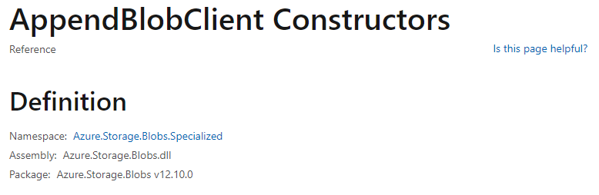
AppendBlobClient
https://docs.microsoft.com/en-us/dotnet/api/azure.storage.blobs.specialized.appendblobclient.-ctor?view=azure-dotnet#Azure_Storage_Blobs_Specialized_AppendBlobClient__ctor_System_String_System_String_System_String_

Slide 14
Azure SQL database
Like normal SQL

